Slide 1


ETL Project: Video Game Sales
Billy Lau
Jay Cha
Chris Obonaga

Slide 2

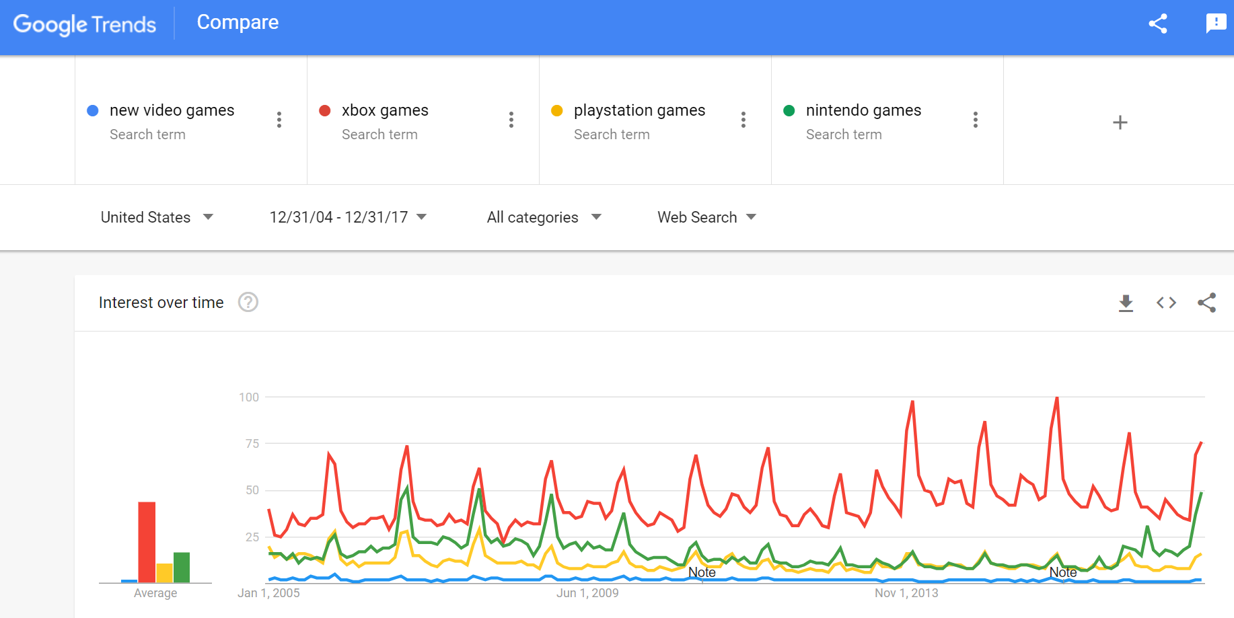
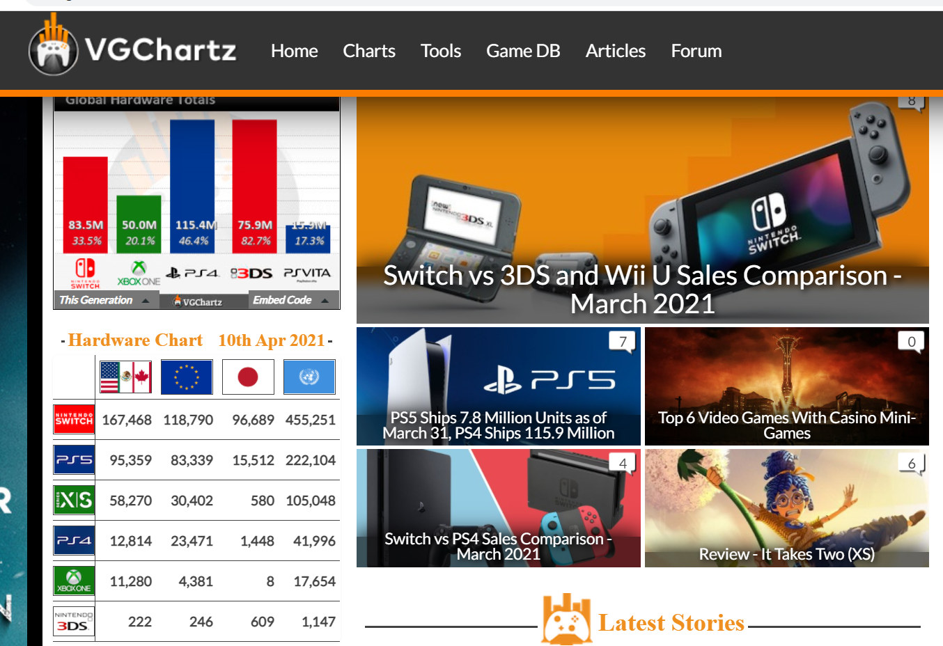
Extract
Google Trends (CSV)
Cleanup prior to pull
Web Scraping (http://www.vgchartz.com)
Too much data (>13k records)

Slide 3
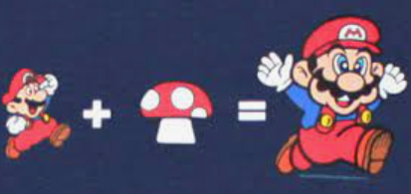
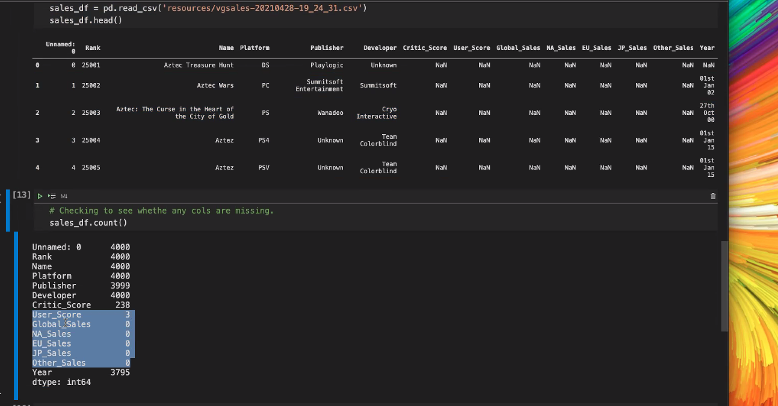
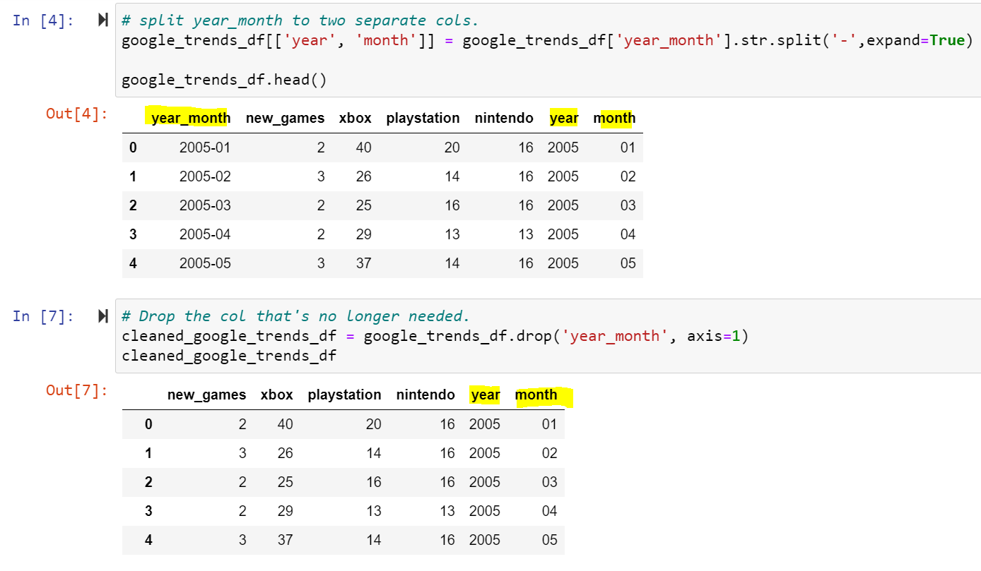
Transform
Data Cleanup
Data imported into Pandas Dataframes
Dropping “NaN”
Changed date “yyyy-mm” to individual columns for “yyyy” and “mm”
Remove embedded units in sales data (ie: 0.05M)

Slide 4

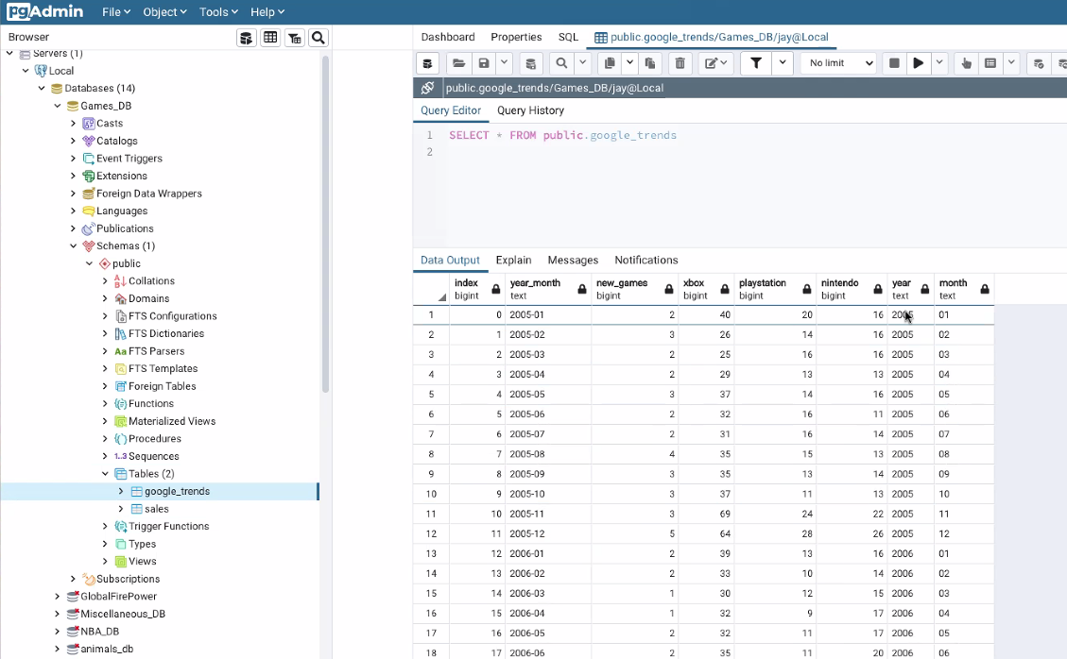
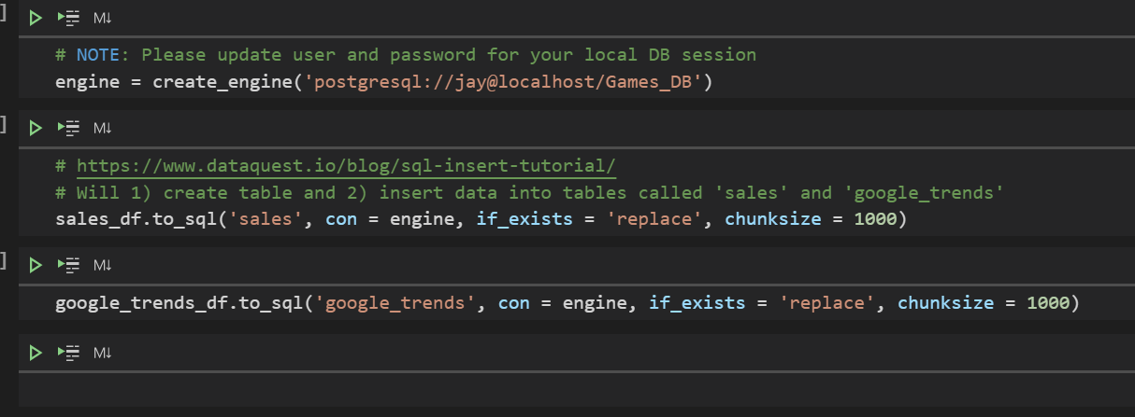
Load
PostgreSQL (RDMS )
SQL Alchemy to connect to database
Pandas to_sql method handles both database schemas and data insertion

Slide 5

Questions?

